Slide 1
6th International symposium „New Economy“ organized by Oikos Institute
Innovative methods, models and financial resources as the direction of the reform of pension systems
Author: Dražen Bojagić
Co-authors: Srđan Milošević and Ana Vasiljević

Slide 2
content
We have been analyzing pension systems of Chile, Germany and USA, as well as the methods and models of funding those systems and possibilities of their appliance in Republic of Srpska.

Slide 3
The first social security system was established in 1889.
Oto Bizmark
Today the pension insurance system functions as a system of three levels
The first level is consisted of subsystems that operate on the basis of legal standards which are required for a particular group of persons
Approximately 85% of employees are included in the system of public pension insurance
Civil servants, who form part of about 9% of the workforce have "their" pension system as well as those self-employed who choose a certain type of private insurance, provided that they have the opportunity to be part of the public pension system of Germany
Generally speaking, there are four mandatory subsystem of this type

Slide 4
The second level of care provision is consisted of provision in oldages from the company -Direct pension promise, -Download employee life insurance policies, -"Pensionskasse" -Pension funds for this type of insurance and -Funds for support.
The third level of protection in the oldages is consisted of self-care private mode which is also voluntary
These private plans include (but they are not limited to) plans "Riester" and "Rürup"
"Riester" - subsidized by the Government, is suitable for those with lower incomes, and it also can be a classic, unique, bank savings plans and two types of contracts on construction loans
The resulting pension amount is 100% taxable

Slide 5
Rürup 'pension plan is more flexible compared to the previously mentioned and is suitable for those self-employed. There are three varieties: classic, unique and direct
When a person withdraws from a pension fund, a certain percentage of the pension is taxed. In 2016 it was 74% of the amount of pension benefits
Key indicators:
Key issues: demographic situation, the growth of public pension expenditure, informal work, lack of labour (secondary education level)
 |  | Germani | OECD
Average salary | EUR | 47.809 | 34.803
 | USD | 50.307 | 36.622
The expenses of public pensions | % of GDP | 10,1 | 8,2
Life expectancy |  | 81,3 | 80,9
The population above 65 year old | % working age population | 34,8 | 27,9

Slide 6
Retirement system and types of US retirement plans
The holders of funds which today control $131 trillion are:

Slide 7
A pension plan has two primary elements:
The future liabilities, or benefit obligations, created by employee service.
The pension fund, or plan assets,that are used to pay for retiree benefits.
Funded Status = Plan Assets - Projected Benefit Obligation

Slide 9
Types of retirement plans:
IRAs
401(k)s and other employer-sponsored retirement plans
Employer-sponsored retirement plans
Retirement plans for small-business owners and self-employed individuals

Slide 11
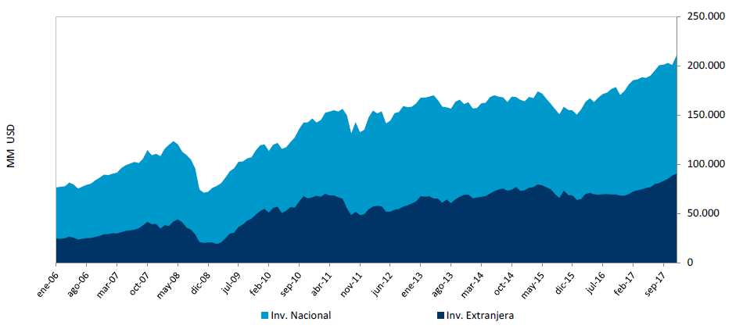
AFP kompanija | Vlasnik (Ownership) | Zmelja vlasnika (Country of Owner)
Capital | Grupo Sura ING | Colombia
Cuprum | Principal | United States
Habitat | Chilean Construction Chamber | Chile
Modelo | Atlantic Investment (individual shareholders) | Chile
PlanVital | AFG Pactual | Brazil
Provida | MetLife | United States

Slide 12
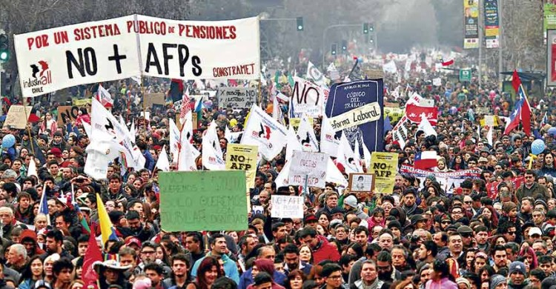

Slide 13
GODINA | 2012. | 2013. | 2014. | 2015. | 2016. | 2017. | 2018.
Osiguranici | 276.195 | 276.267 | 280.511 | 286.310 | 292.811 | 300.202 | 301.501
Korisnici penzije | 238.576 | 244.684 | 249.279 | 252.213 | 257.609 | 260.580 | 258.985

